Slide 1
XOPPY
Manuel Sanchez del Rio
ALS-U / Visiting scientist (on leave from ESRF)
December 11, 2019

Slide 2
Outline
History
Tutorial
Exercises
Sources: Flux and Power
Examples
Second OASYS School – ANL APS - December 11-13, 2019
2

Slide 3
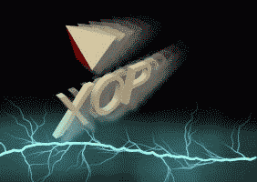
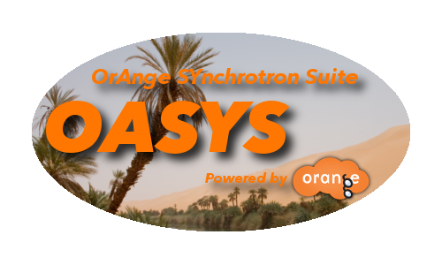

History
XOP
X-ray OPtics utilities
1997 – Manuel Sanchez del Rio & Roger J. Dejus
This code is a graphical user interface that performs calculations of radiation characteristics of X-ray sources and their interaction with matter, such as: insertion devices (undulator or wiggler) spectra and angular distributions, mirror and multilayer reflectivities, and crystal diffraction profiles [1].
XOP
+
=
XOPPY
[1] Manuel Sanchez del Rio and Roger J. Dejus "XOP: a multiplatform graphical user interface for synchrotron radiation spectral and optics calculations", Proc. SPIE 3152, Materials, Manufacturing, and Measurement for Synchrotron Radiation Mirrors, (1 November 1997); https://doi.org/10.1117/12.295554.
Second OASYS School – ANL APS - December 11-13, 2019
3

Slide 4



XOPPY in OASYS
SRW
WOFRY
XOPPY
https://github.com/oasys-kit/wofry
SHADOWOUI
OASYS = OrAnge SYncrotron Suite
SYNED
https://github.com/oasys-kit/syned
Orange
Luca Rebuffi (ANL) & Manuel Sánchez del Río (ESRF) [1].
COMSYL
https://www.aps.anl.gov/Science/Scientific-Software/OASYS
https://github.com/oasys-kit
Utilities
[1] L. Rebuffi, M. Sanchez del Rio, "OASYS (OrAnge SYnchrotron Suite): an open-source graphical environment for x-ray virtual experiments”, Proc. SPIE 10388, 103880S (2017)​​​​​. DOI: 10.1117/12.2274263.
Second OASYS School – ANL APS - December 11-13, 2019
4

Slide 5
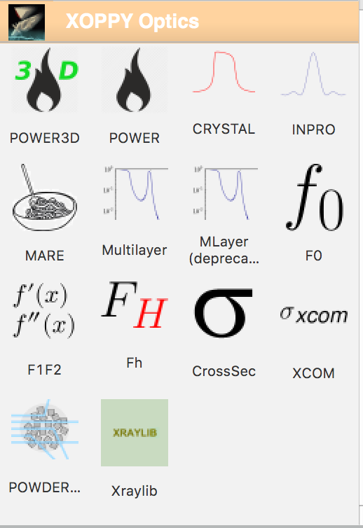
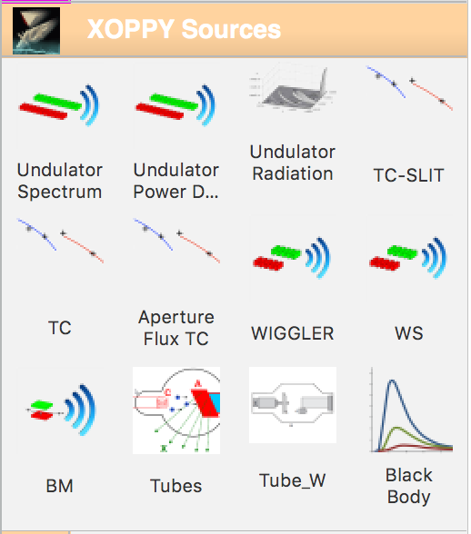
Package
Second OASYS School – ANL APS - December 11-13, 2019
5

Slide 6
Applications
Synchrotron Sources
Bending Magnets, Wigglers : Spectral Flux and Power
Undulators:
Spectral Flux, Spectral Power W(E) + Elements (mirrors, filters)
Power Density W(x,y)
Radiation W(E,x,y) + Elements (Mirror, filters, apertures)
Several calculation engines on the same interface (US, URGENT, SRW, pySRU)
Optical elements reflectivity (crystals, mirrors, multilayers)
Miscellaneous applications
Second OASYS School – ANL APS - December 11-13, 2019
6

Slide 7
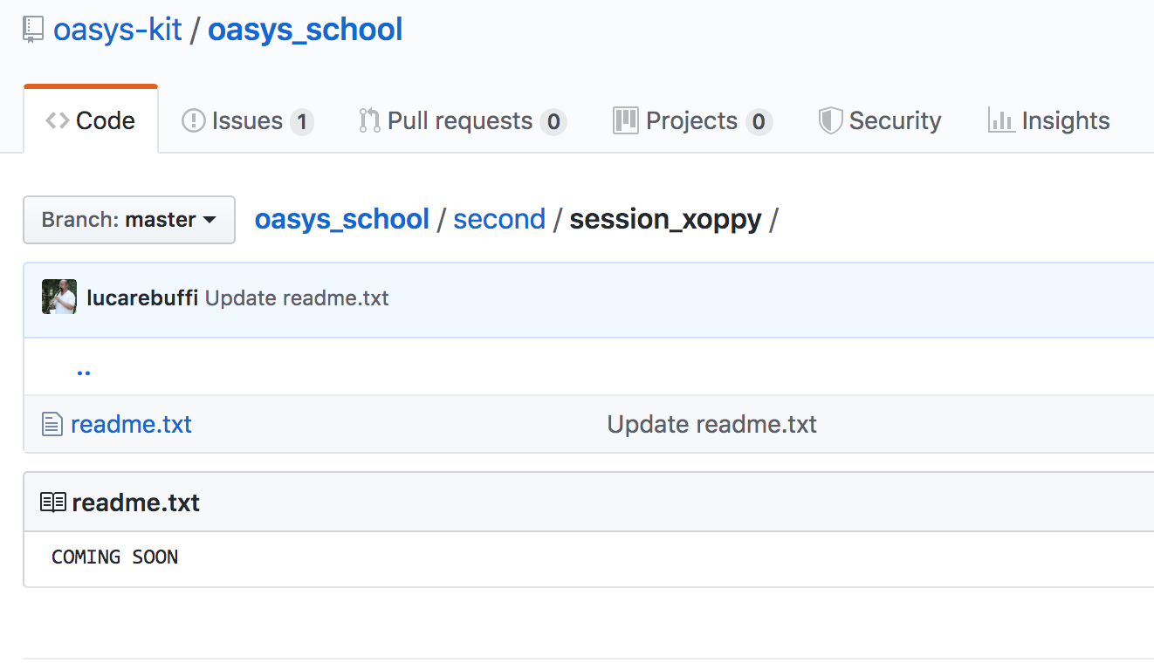
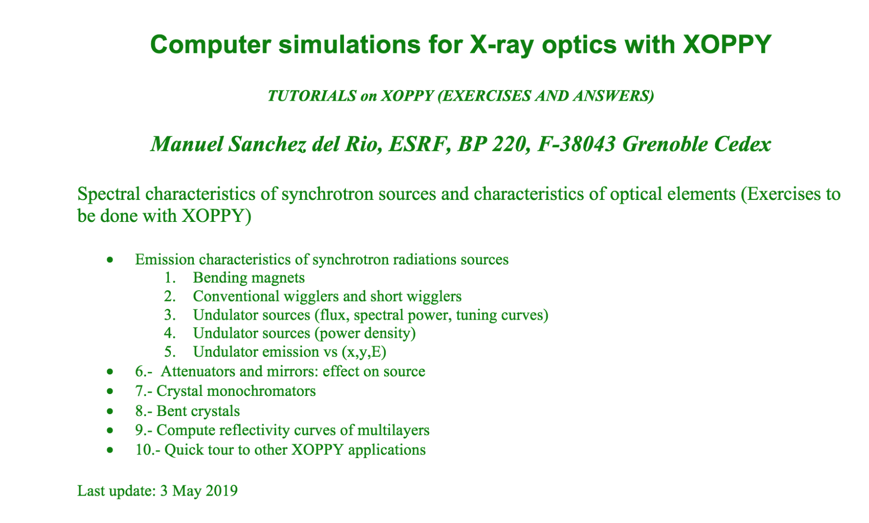
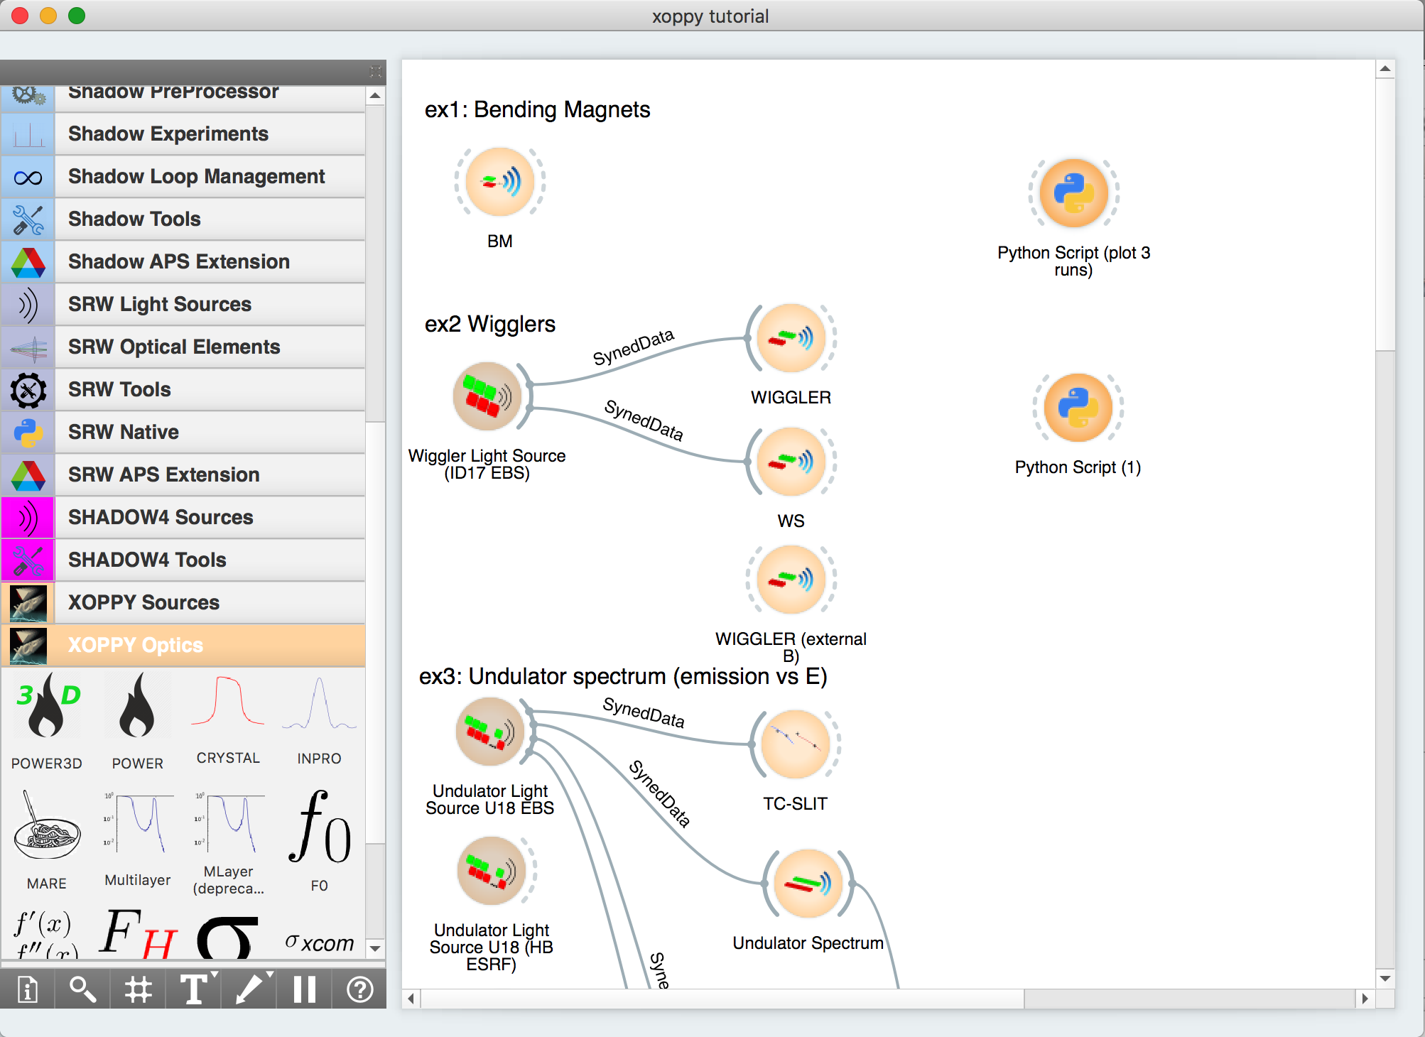
Tutorial
Second OASYS School – ANL APS - December 11-13, 2019
7

Slide 8
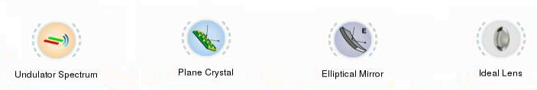
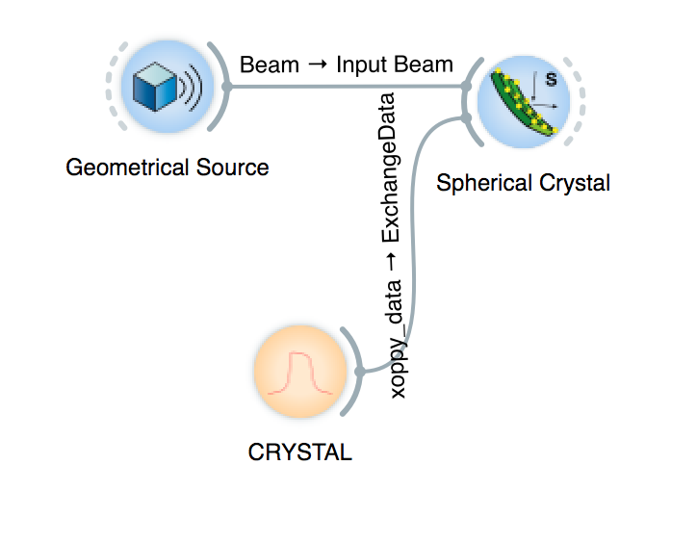
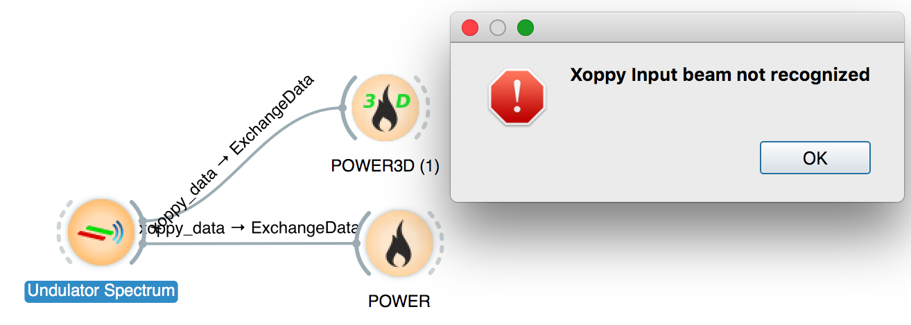
Connectivity & Interoperability
XOPPY
SHADOWOUI
SRW
WOFRY
Hint: always keep an eye on the color code
SHADOWOUI
XOPPY
XOPPY
Second OASYS School – ANL APS - December 11-13, 2019
8

Slide 9
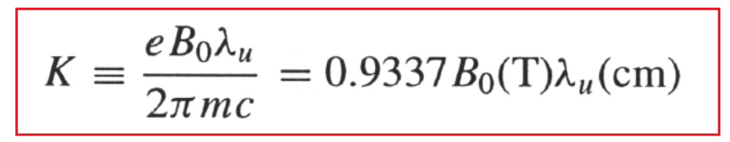
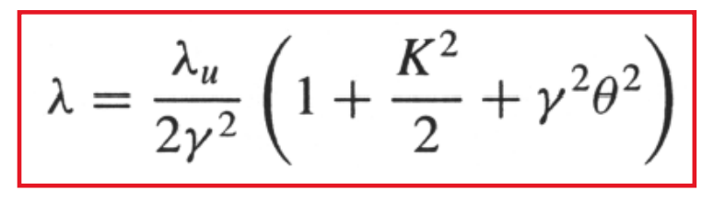
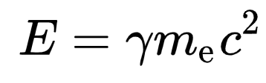
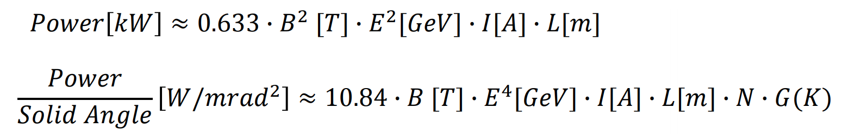
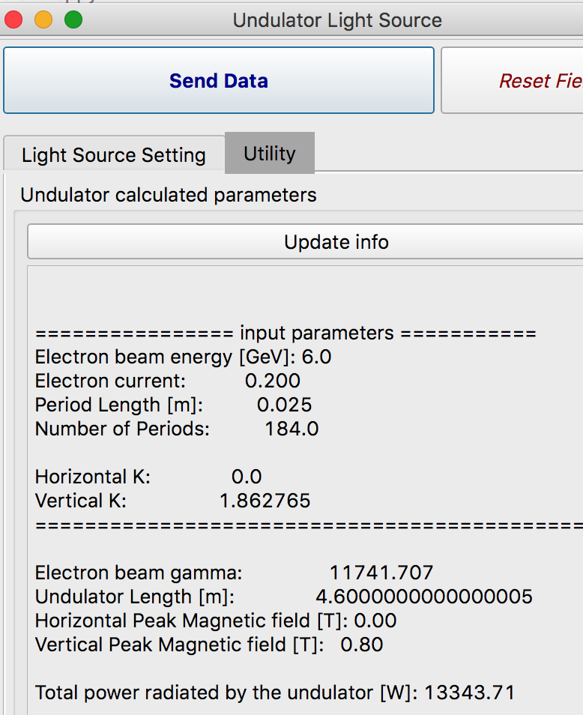
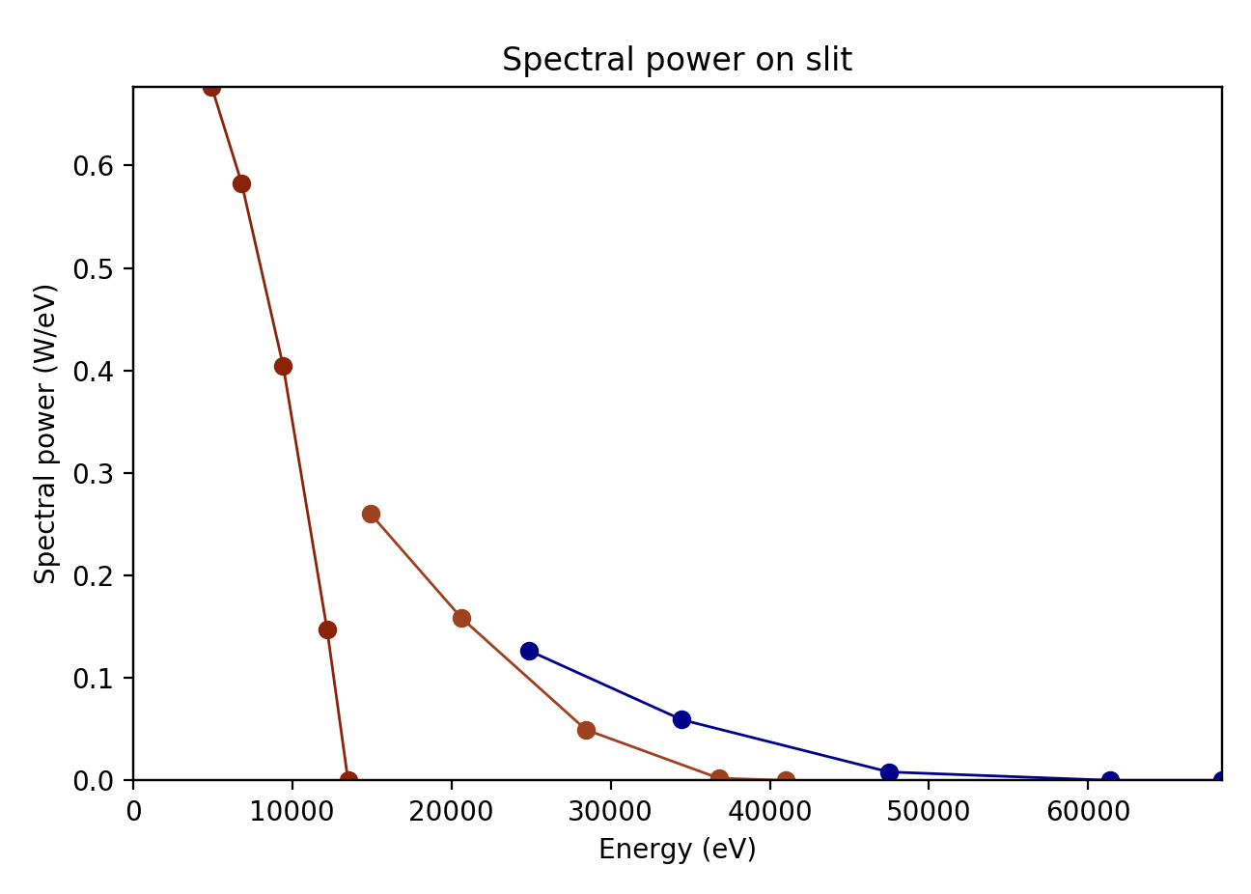
Undulators: Power and spectral calculations
m_{e}c² = 0.51 MeV
Maximum power is obtained at highest K (or B) corresponding to the minimum photon energy
The spectral range covered by undulator is shown by the Tuning Curves.
Second OASYS School – ANL APS - December 11-13, 2019
9

Slide 10
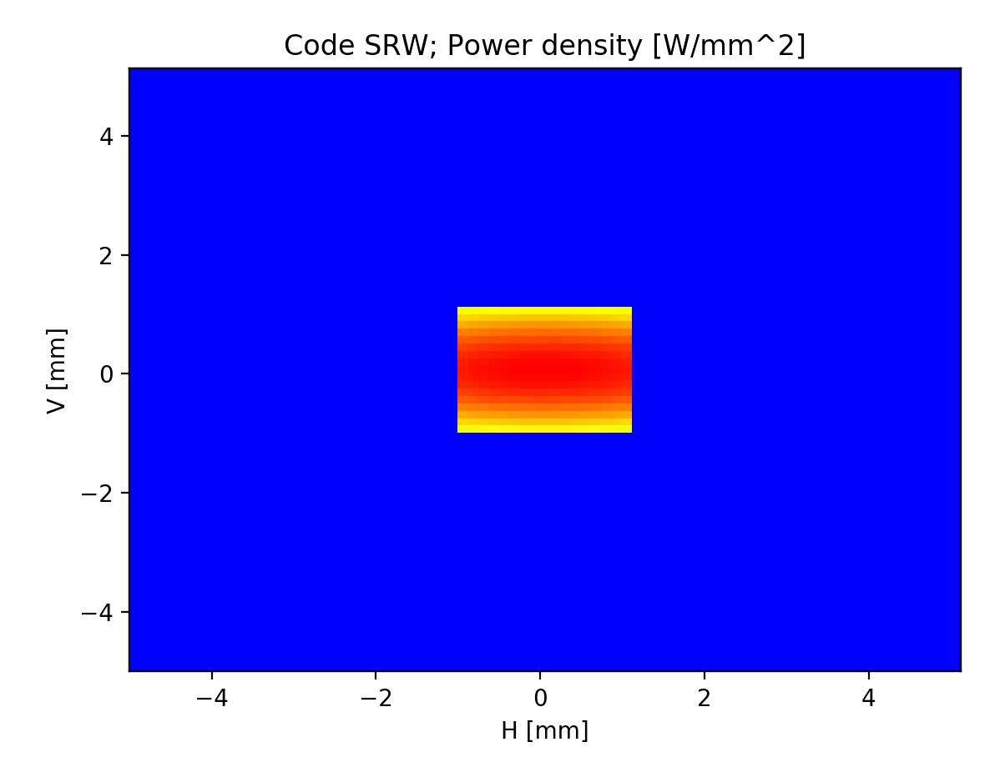
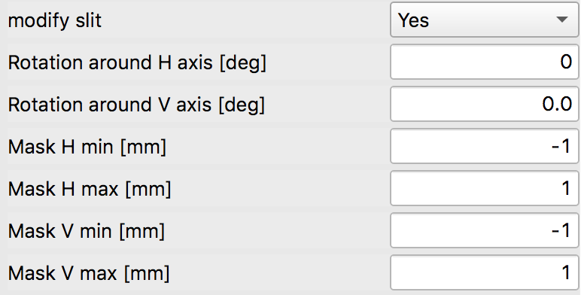
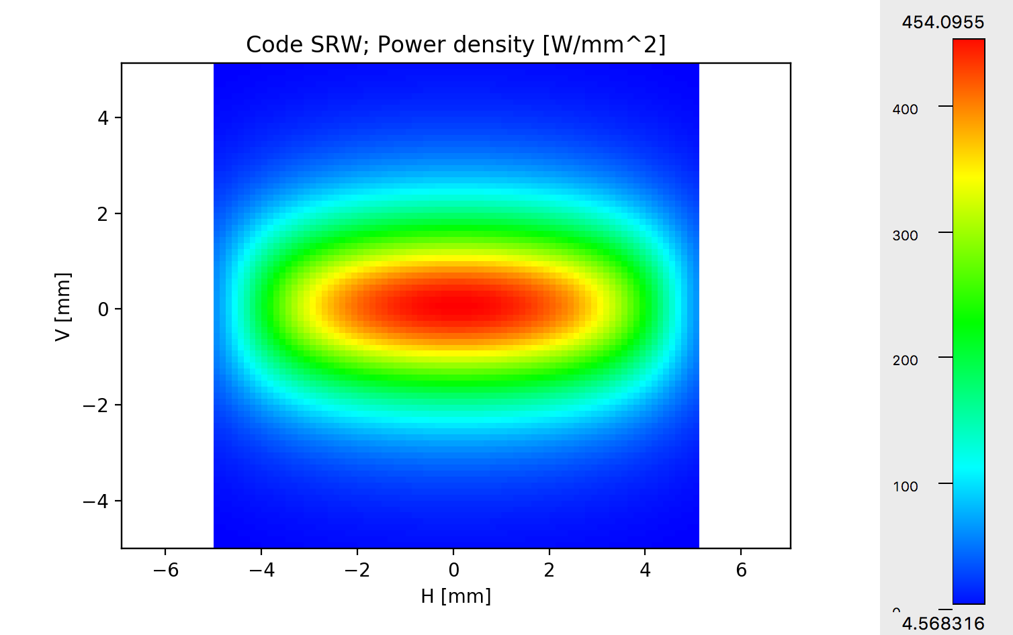
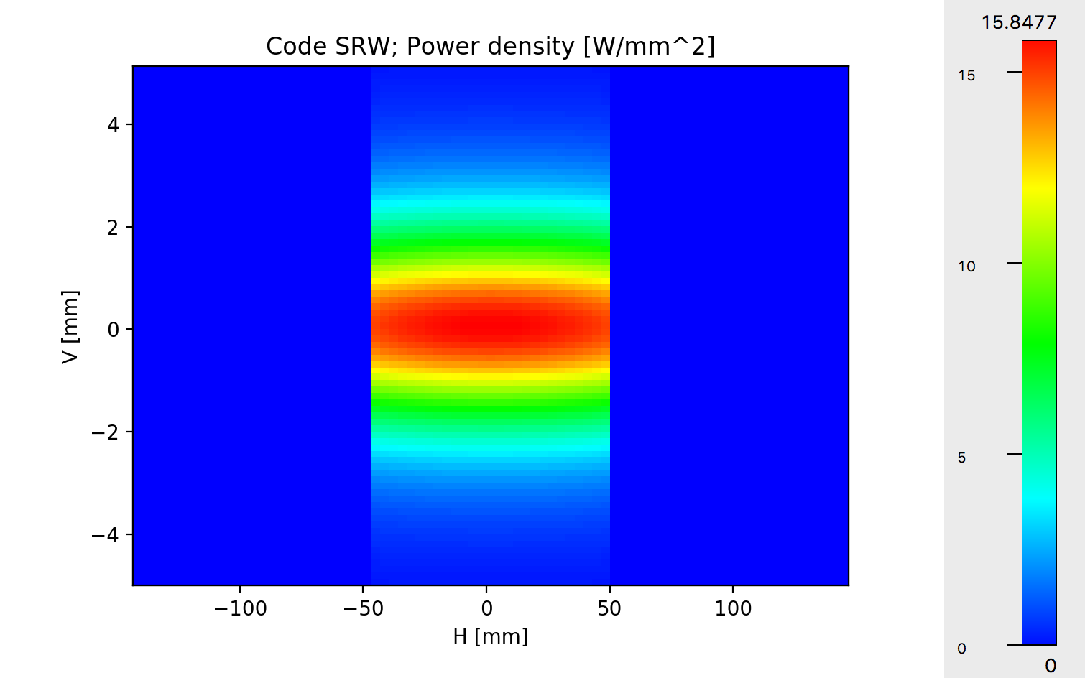
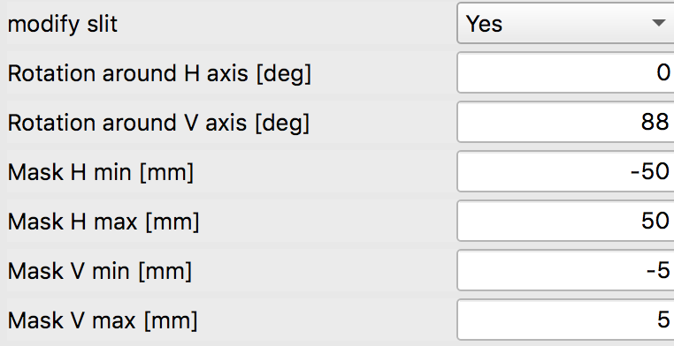
Power density (Power vs X and Y)
6 sigma 1.32 mm
Tips:
Calculate on aperture large enough to accept all the radiation
Select “modify slit” to calculate power on smaller slit and to calculate power density on mirror surface
Second OASYS School – ANL APS - December 11-13, 2019
10

Slide 11
Outline
History
Tutorial
Exercises
Sources: Flux and Power
Examples
Second OASYS School – ANL APS - December 11-13, 2019
11

Slide 12
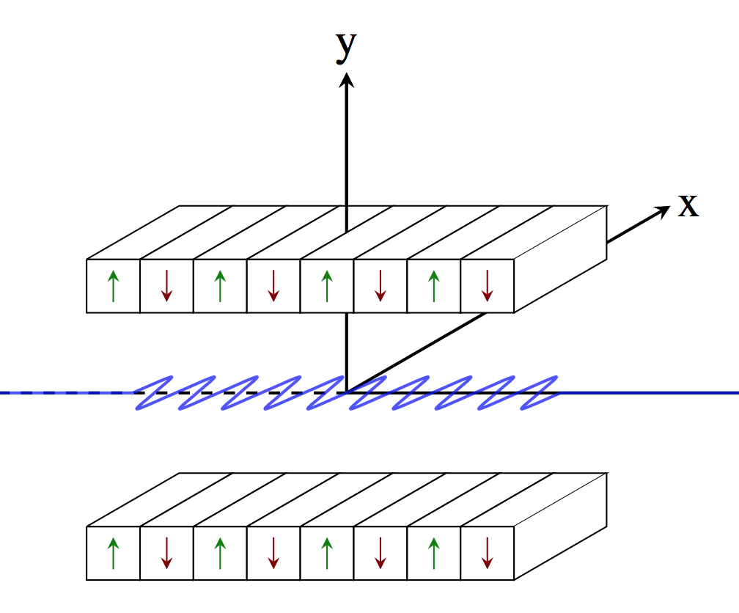
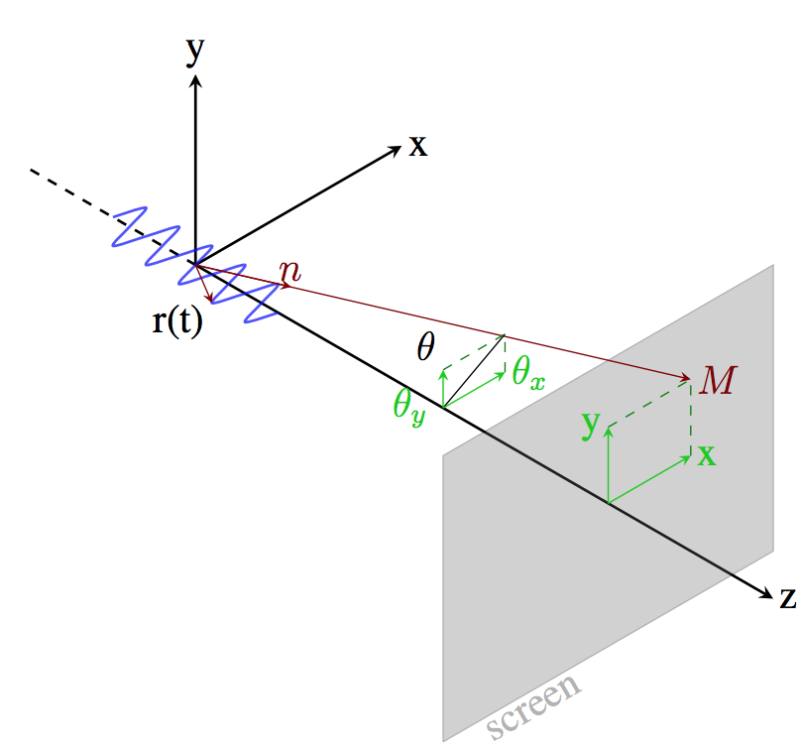
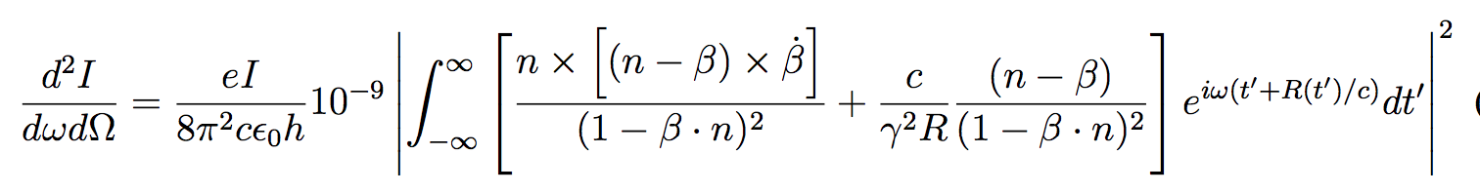
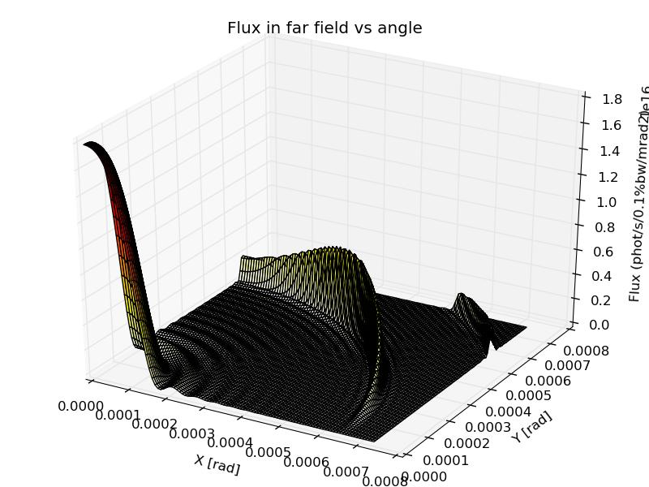
Flux and Spectral Power
Undulator emission, after classical electrodynamics (e.g., Jackson, etc)
Second OASYS School – ANL APS - December 11-13, 2019
12

Slide 13
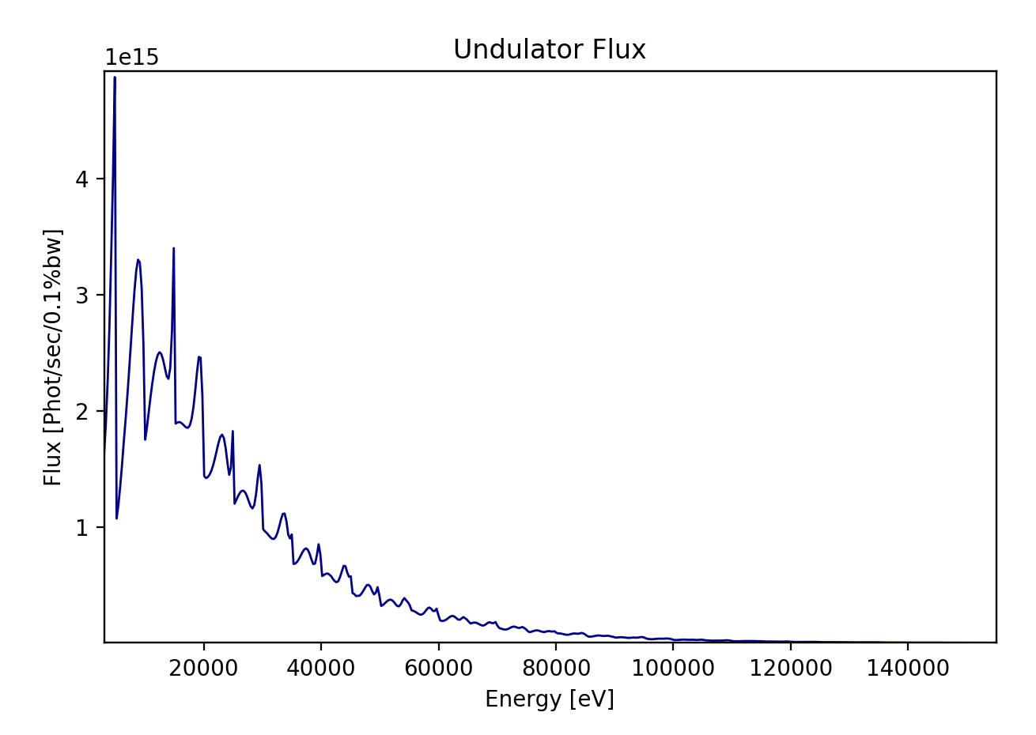
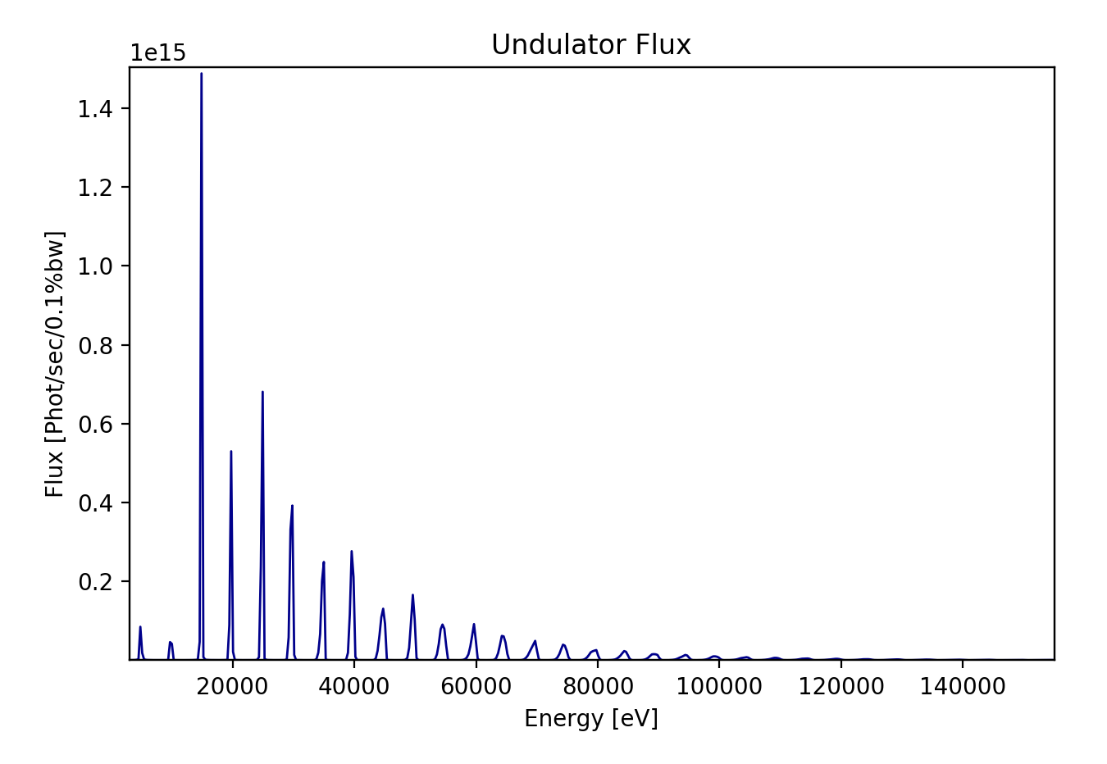
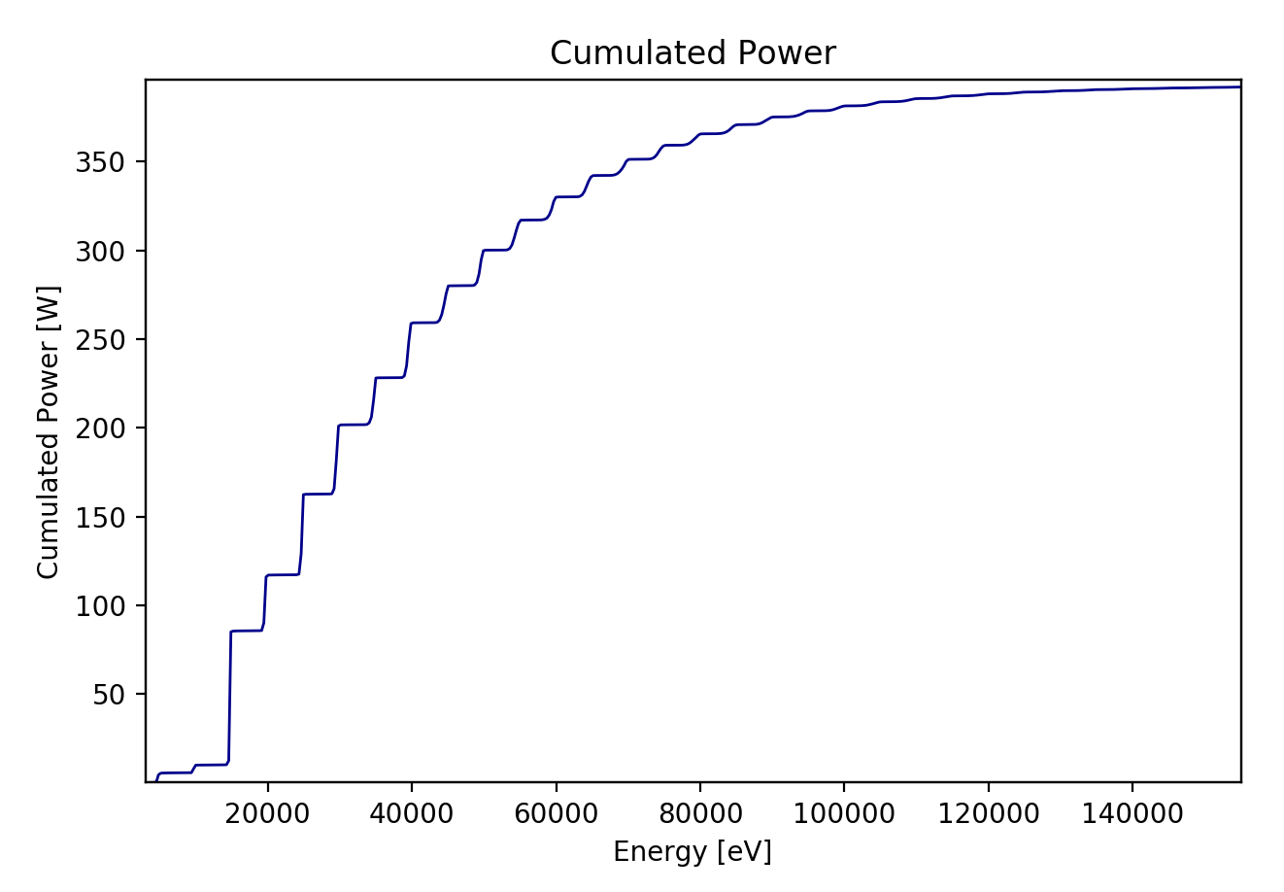
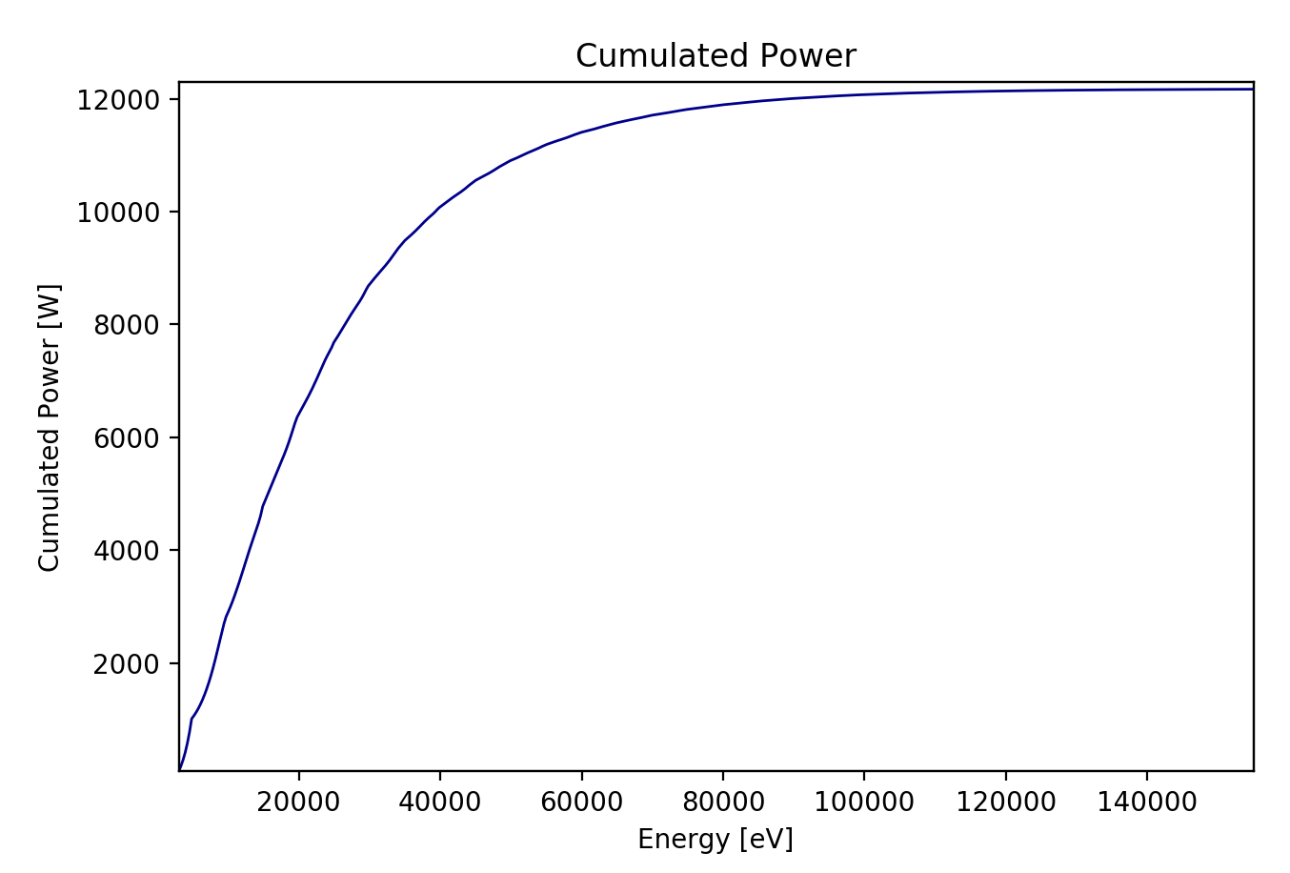
Flux and Spectral Power
Open Slit (10 x 10 mm2)
Slit (1 x 1 mm2)
Second OASYS School – ANL APS - December 11-13, 2019
13

Slide 14
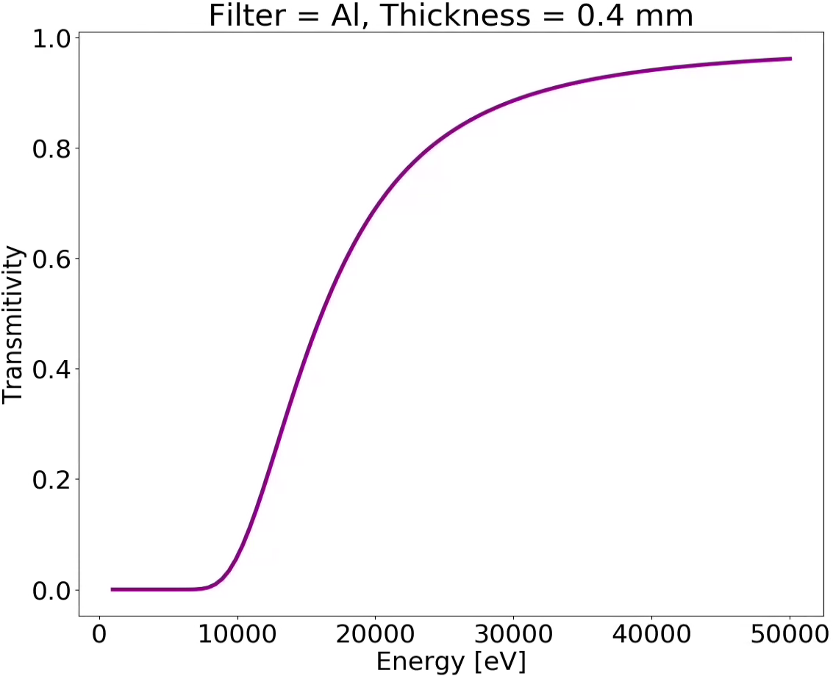

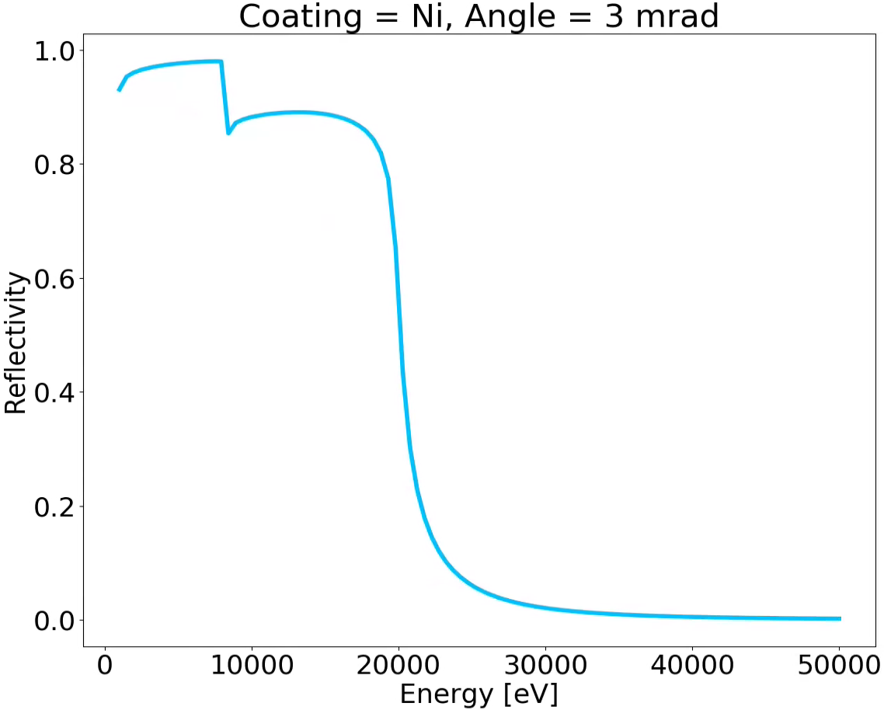
Spectral response of mirrors and attenuators (filters)
XOPPY
Interaction of radiation with matter
0.4 mm
X-ray beam
Al
X-ray beam
Mirror Angle
Ni coating
Second OASYS School – ANL APS - December 11-13, 2019
14

Slide 15
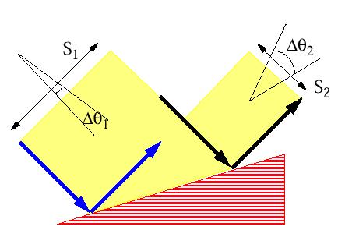
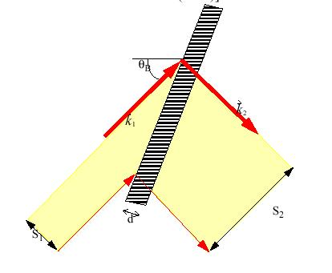
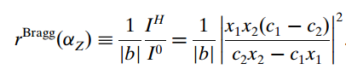
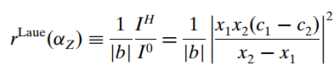
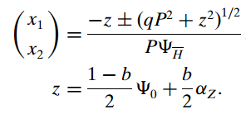
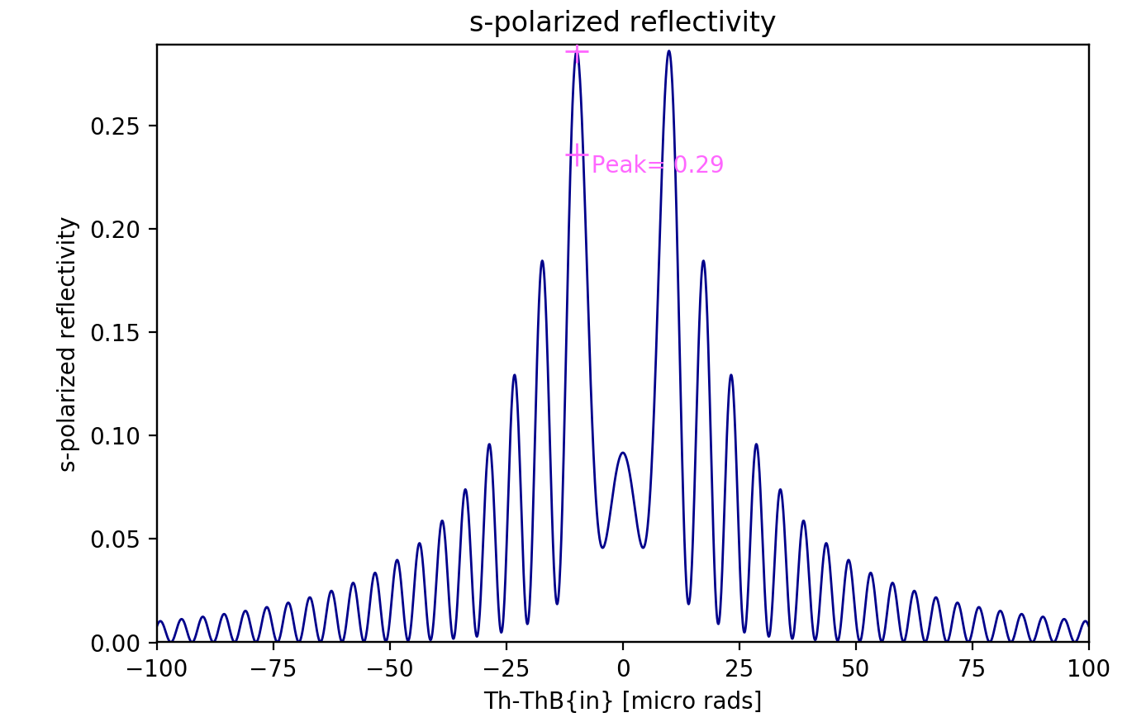
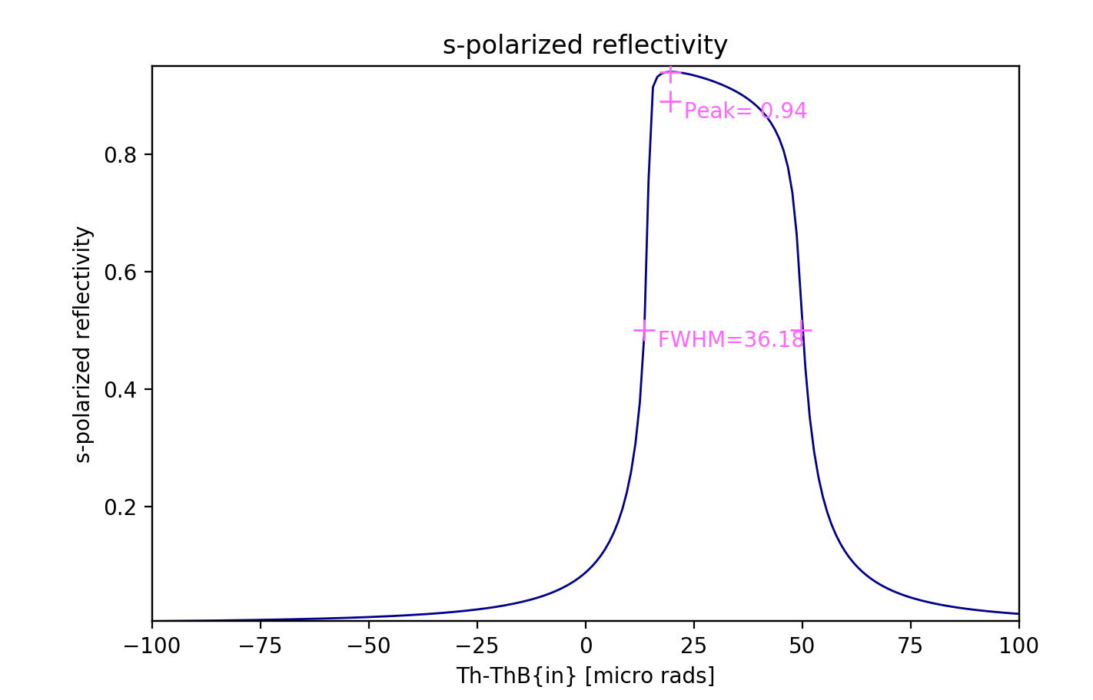
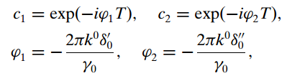
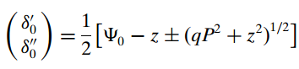
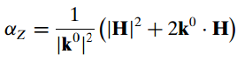
Crystals: Zachariasen treatment for plane crystals
BRAGG or reflection
LAUE or transmission
Second OASYS School – ANL APS - December 11-13, 2019
15

Slide 16
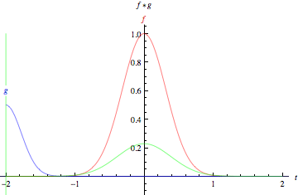
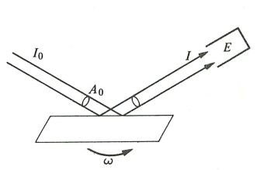
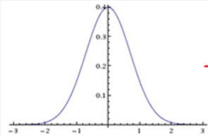
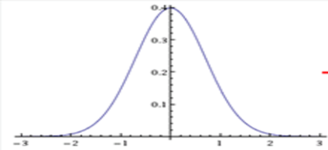

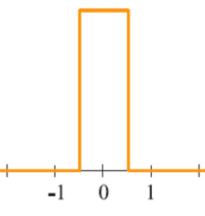
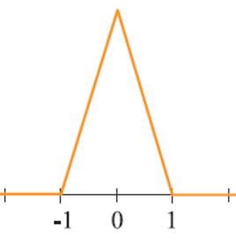
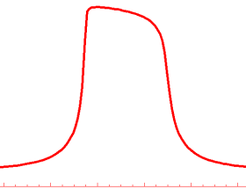
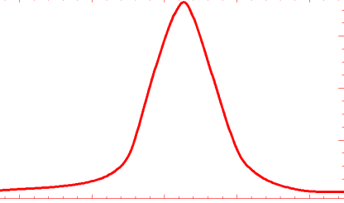
Crystals: Rocking curves
The rocking curve is the CONVOLUTION of the two diffraction profiles.
=
FWHM_{R} = 1.4 FWHM₁
=
FWHM_{R} = 1 FWHM₁
=
FWHM_{R} ~ 1.5 FWHM₁
_{Si111 8 keV}
For a full discussion about rocking curves see: Masiello et al. J. Appl. Crystall. 47, 1304-1314 (2014)
Second OASYS School – ANL APS - December 11-13, 2019
16

Slide 17
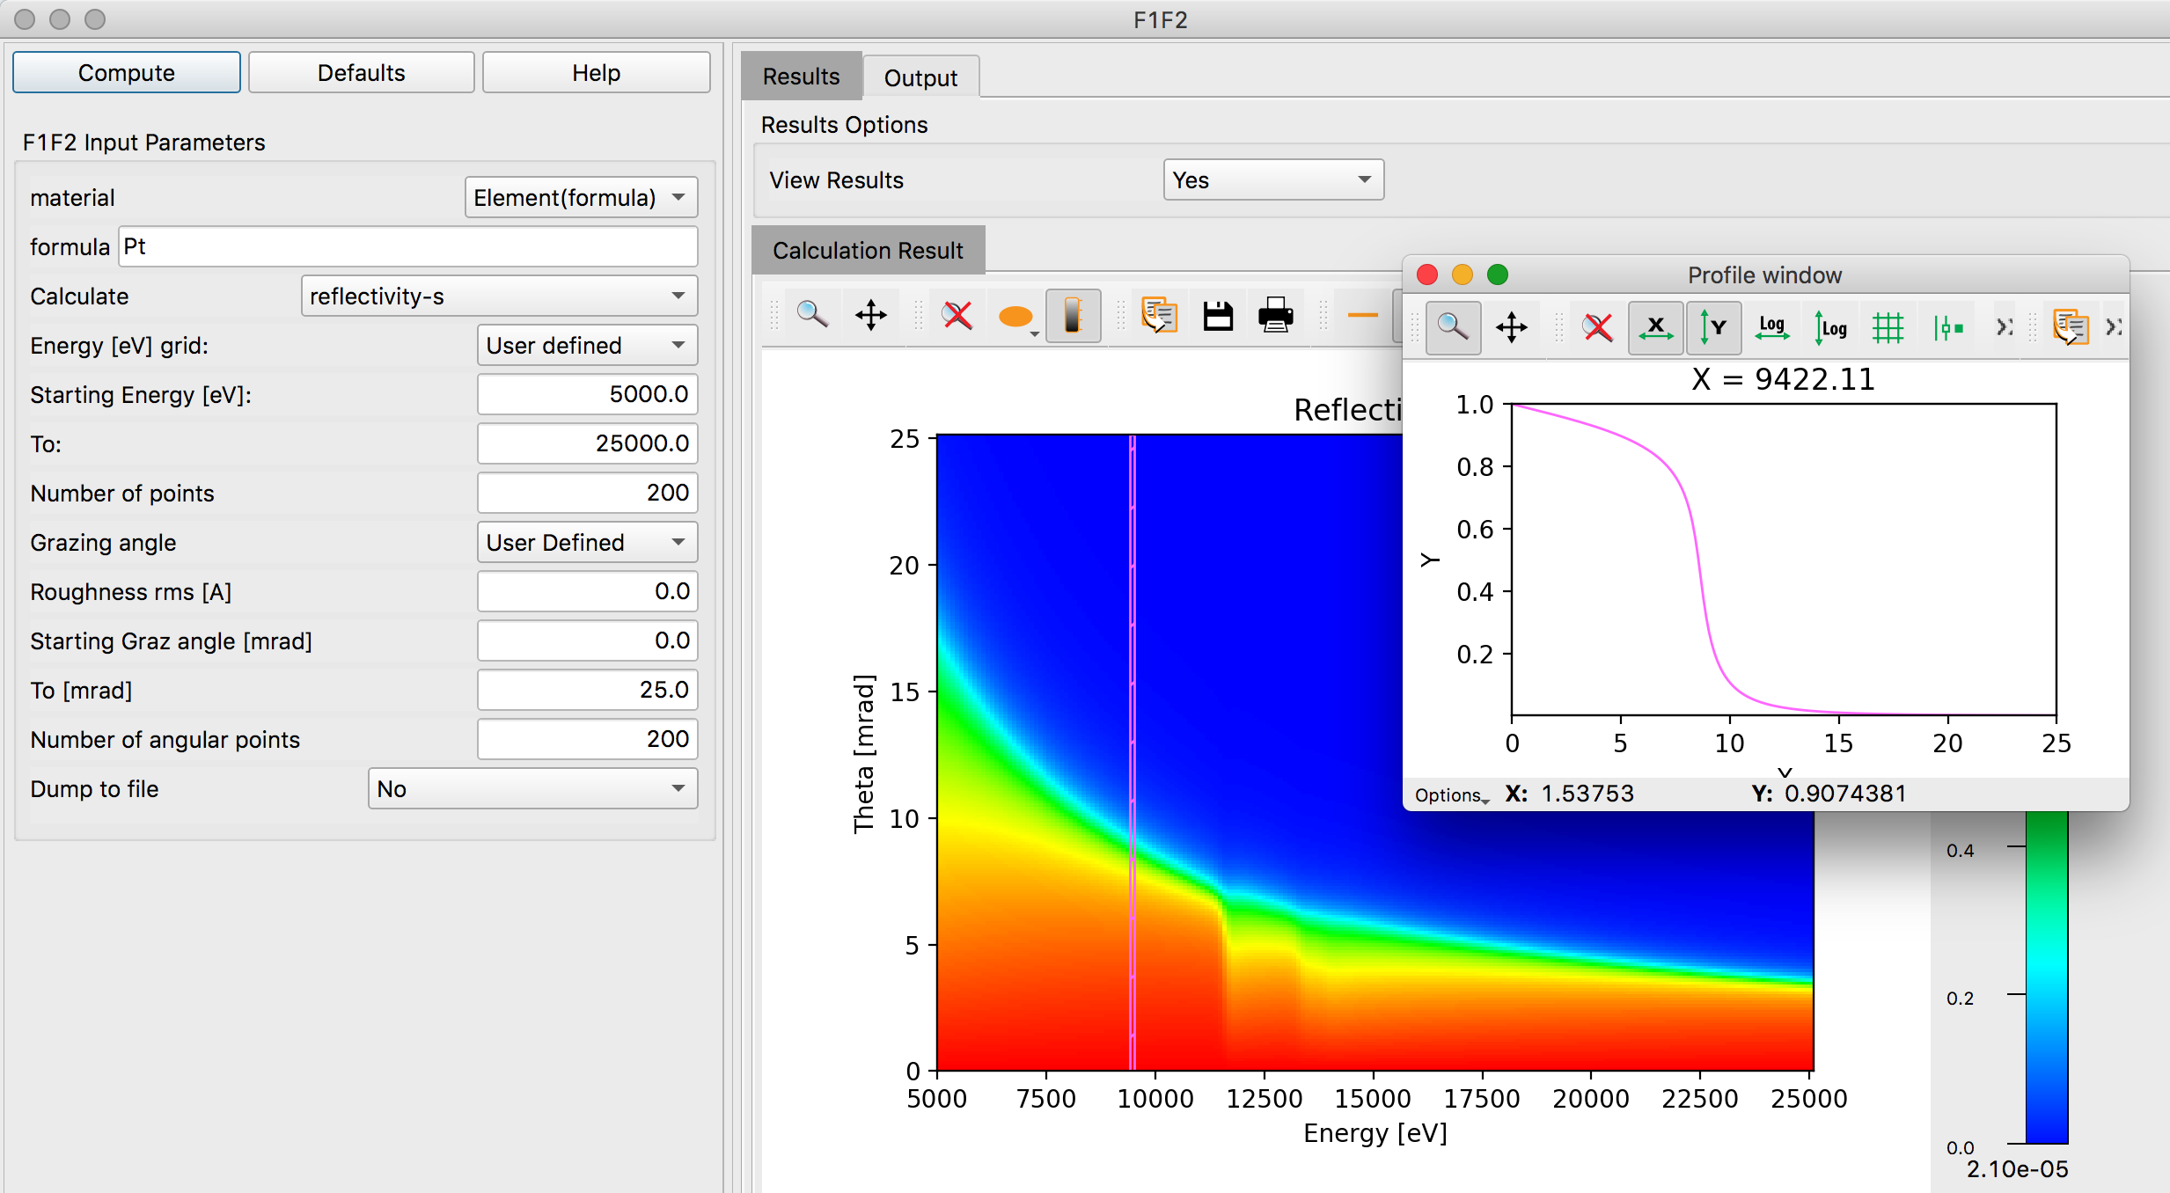
Mirror reflectivity F1F2
Second OASYS School – ANL APS - December 11-13, 2019
17

Slide 18

Multilayer reflectivity
Second OASYS School – ANL APS - December 11-13, 2019
18

Slide 19





Multiple Bragg Diffraction
Simultaneous multiple diffraction occurs when the incident wave finds several sets of planes satisfying the Bragg law.
They were first discovered by Renninger (1937) so they are called Renninger reflections of detour reflections (umweganregung).
Kinematical theory (Cole, Acta Cryst.15 138 (1962); Rossmanith PSILAM; XOP/MARE)
Beyond kinematical theory (Colella, Acta Cryst. A30, 413 (1974); Shen; Stepanov http://x-server.gmca.aps.anl.gov)
Second OASYS School – ANL APS - December 11-13, 2019
19

Slide 20
Acknowledments
Roger Dejus
Luca Rebuffi
Juan Reyes Herrera
Second OASYS School – ANL APS - December 11-13, 2019
20

